Slide 1

GIATAT RESOURCES INT’L LTD.
…providing quality livestock and enhancing efficient transport logistics in Agricultural value chain
Ikechukwu Umezurumba
Founder/CEO
+234 (0) 8036851520

Slide 2
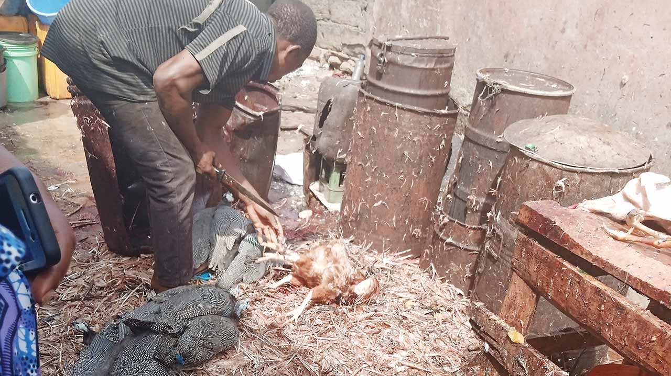
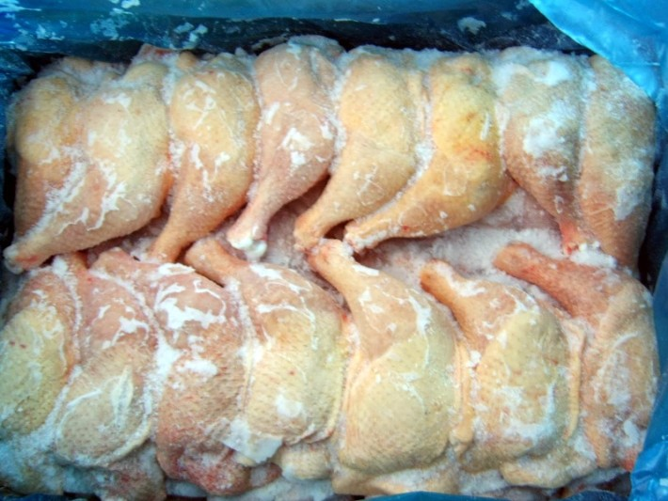
THE PROBLEM
“Nigeria’s Poultry Industry is estimated at over $600 million
70% of processed chicken consumed in Nigeria are imported and are known as ‘cadaver-chickens’.
Cadaver-chickens are unhygienic and lacks the desired satisfaction
Live chicken sold & processed in open market are done in an unhealthy environment.
Inconvenience in going to farms and open market to buy live birds .
Consumers of fresh processed chicken find it difficult to go to farms and open market because of the imposed lock-down

Slide 3



THE SOLUTION
Giatat Resources Int’l ltd is a poultry production and processing company in Nigeria
That is developing an online ordering, logistics and tracking platform that enables consumers of fresh processed chicken to remotely place an order and sees it delivered at their doors steps as well as tracking poultry out-growers production output.
Enables remote ordering
Hygienic Meat
…convenience for Fresh processed chicken consumers

Slide 4
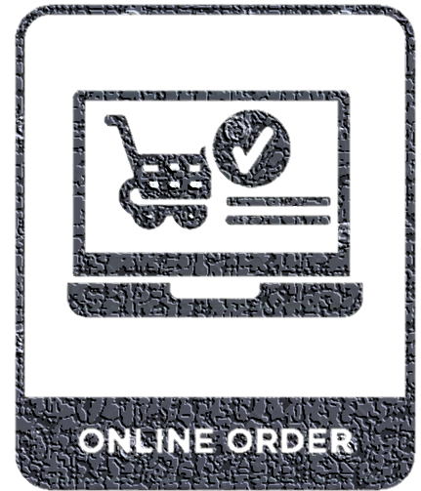

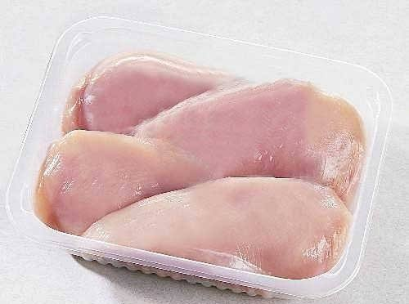
THE PRODUCT/SERVICE
GIATAT
Fresh Processed Chicken
(FPC)
GiaTAT delivery system

Slide 5
THE MARKET
1.5 million metric tonnes of chicken are demanded in Nigeria annually (of which 300,000 metric tonnes are produced in Nigeria)
$8.3 b/y
[TAM]
450,000 metric tonnes are produced in Nigeria with a demand gap of 1.2meric tonnes
$42.5 b/y
[SAM]
Current request for Chicken in Abia State = 5,140 tons/annum (@USD 5555/ton)
Projected revenue from sales/annum = USD 45,000 Annually
(Great opportunity for scaling)
$28.5 m/y
[SOM]

Slide 6
BUSINESS MODEL
OUT-GROWER
POULTRY FARMERS
OUT-GROWER
POULTRY FARMS GPS TRACKER
GIATAT RESOURCES
PROCESSING PLANT
(FRESH PRODUCED CHICKEN)
…GIATAT ONLINE
ORDERING PLATFORM
GIATAT RESOURCES
POULTRY FARM
_HOTELS_
_RESTURANTS_
_INDIVIDUALS_

Slide 7
BUSINESS/COMPETITION
COMPETING PRODUCTS:
(1)NatnudO Chickens (2) Frozen Chicken
(i)Out-grower poultry system but sells processed chicken (i) Mostly imported chicken which
through cold rooms are un-healthy and are not fresh
UNIQUE SELLING POINTS: (1) It adopts innovative flexible online ordering system
(2) Offers its consumers fresh processed chicken.
(3) Efficient delivery system that delivers processed chicken at the door
door steps of consumers
(4) Out-grower tracking application that keeps track of out-growers
production
MARKETING STRATEGY: (1) Creating awareness through social media platform
(2) Placing adverts during special programs
CHALLENGES: (1) Inability to meet demand: Adopting a consumer aggregation model to
determine consumers demand need per day
(2) Steady availability of live broilers: Tracking out growers broiler production
(3) Delivering all orders promptly: setting up ordering periods to enable easy
delivery

Slide 8
TRACTION
POULTRY PRODUCTION
+
OUTSOURCING
+
PROCESSING
+
DELIVERY
POULTRY PRODUCTION
+
OUTSOURCING
+
PROCESSING
POULTRY
PRODUCTION
2012
2015
2021
2023

Slide 9
FUTURE TIMELINE
CURRENT STATE
FUTURE STATE
1.Individual household utilizing the product.2.Resturants and fastfoods demanding the product but taking delivery by themselves
Individual household and corporate organization to utilize our product
Buyers and Early Adopters
1.Consumers of fresh processed chicken wants are satisfied
Satisfying Consumers wants and enhancing their convenience in purchasing fresh process chicken
Goals Achieved
Target Location
1.Currently serving a customer base in one city of the state using other means of delivery
1.Serving a customer base in 9 states of the Niger Delta 2.Gaining 40% market share in the Niger Delta Region.

Slide 10
FINANCIALS
Average Revenue Stream for 2017 – 2019 is from sale of live chicken
Projected Revenue Streams By End of 2020
20 % of annual revenue was from sale of live broilers
80 % of annual revenue was from sale of fresh processed chicken to individuals and cold rooms
Projected Revenue Streams by End of 2021:
100% of annual revenue will be from sale of fresh processed chicken and our delivery system
Financial Year (FY): January - December
USD ‘ | FY 18 | FY 19 | FY 20 | FY 21 | FY 22
Total revenue: | 4000 | 4667 | 7444 | 10000 | 45000
Total expenses: | 3200 | 3734 | 5955 | 8000 | 30000
EBITDA | 800 | 1013 | 1641 | 2246 | 15000
EBITDA Margin | 20% | 21% | 22% | 22% | 33%
NET PROFIT | 519 | 732 | 1360 | 1965 | 10757

Slide 11
CAPITAL REQUIREMENT
Details | Amount (USD)
Funds Infused: Personal investment (2010 – 2020): Grant from *FADAMA (2010 - 2013): Grant from **IFAD (2013-2015): | 7916.00 2777.00 2083.00 3056.00
Asking fund: | 5,000.00
*FADAMA: World Bank assisted project in Nigeria
**IFAD:International Fund for Agricultural Development
Use of Fund:
Development of GPS enabled online ordering applications at $1855 and Purchase of Motor Bikes at $3145,

Slide 12
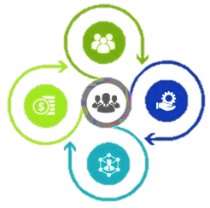
IMPACT
50% Reduction in glut by poultry Out-grower farmers(SDG 2)
75% Increase in number of employees
(SDG 8)
50% Increase
in Poultry Out-growers Income (SDG 8)
75% Increase in quality of processed chicken sold (SDG 9)
Response to COVID-19 prevention (SDG 3)

Slide 13
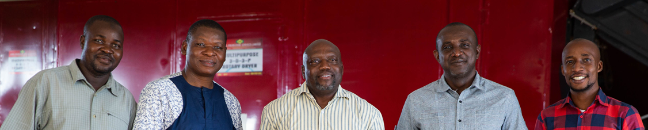
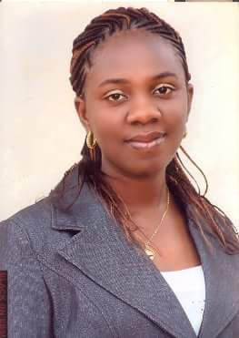
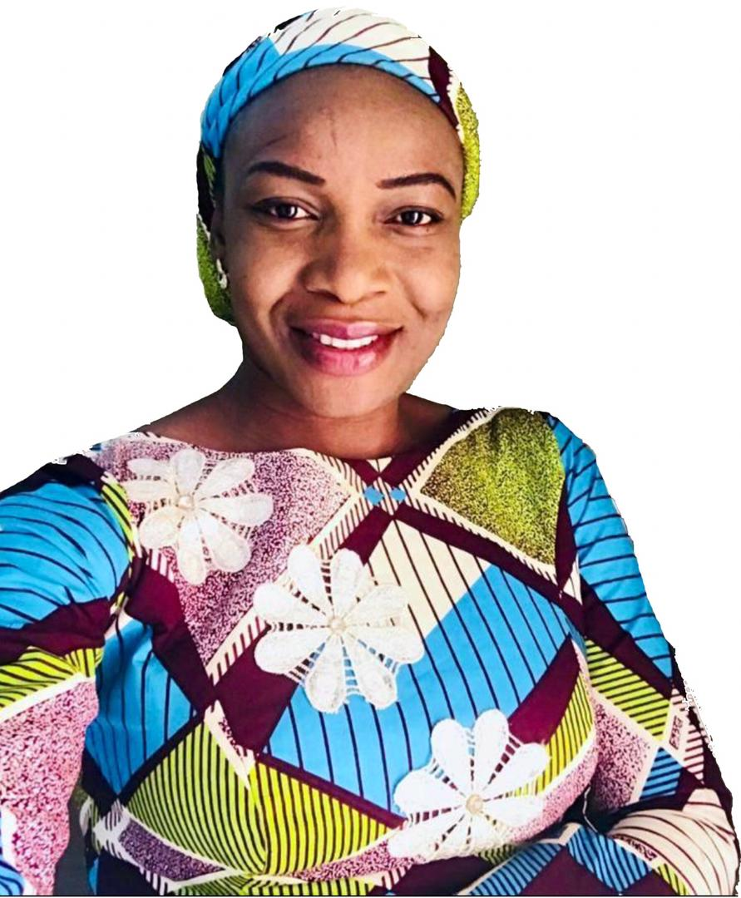
CORE TEAM
Iyke Umezurumba
BSc, Agric. Economics
MSc, Financial Management
Founder/CEO
Ogechi Njoku
BSc, Food Science&Technology
Production Manager
Iilian Onyegbulam
BSc, Agric. Economics
MSc, Human Development&Food Security
Value Chain Manager

Slide 14

THANK YOU !!

